Slide 1
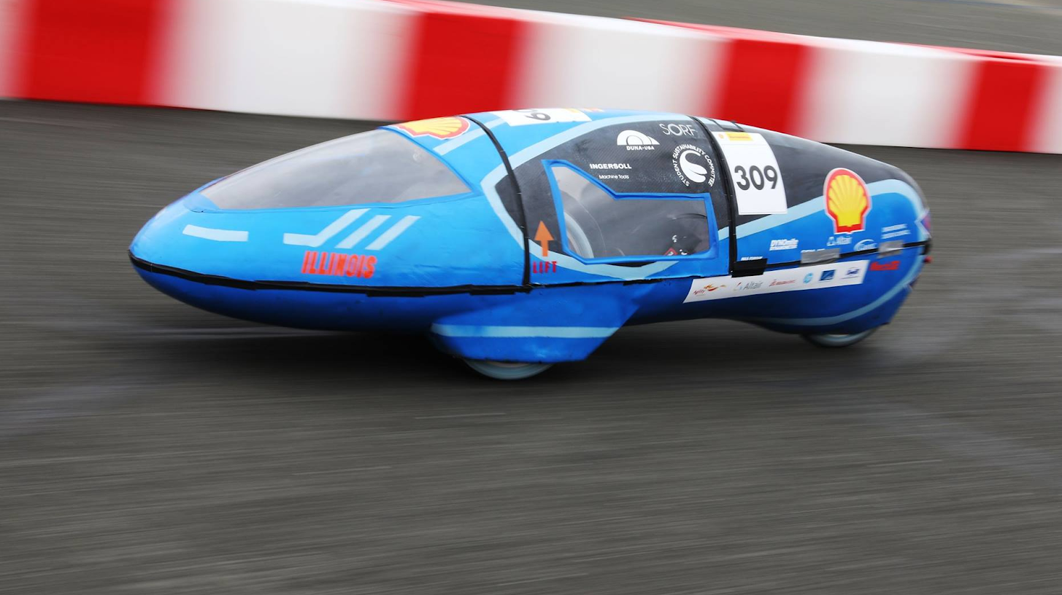

Eco Illini Supermileage
Week:
4/20/2020

Slide 2
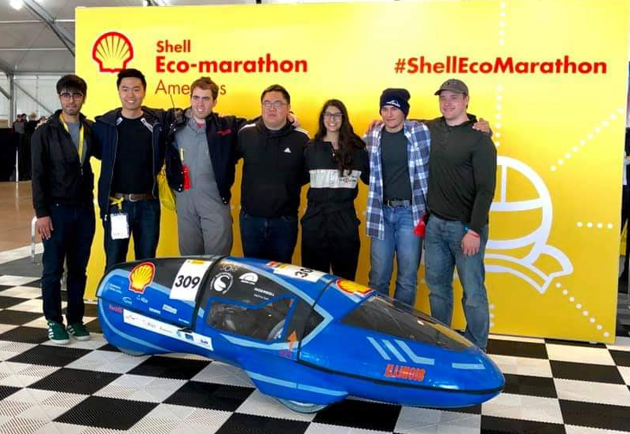
Timeline
Goals for the week:
Aero, Business Leads?
Website Work Continues
Team lead info
G1-5 Info/Photos
As polished as possible, review by 5/2/20
ELT 20/21 Meeting date/time secured
ELT (Eco Lead. Team) to Slack and Background Google Form
This week in review (TWIR):
Mechanical Leads secure
Treasurer and Safety officer secured
Website content updated, good plan in place

Slide 3
Leadership Structure 2020-2021
Stefan Kamzol (President), Sr
Justin Kao (Captain), So
Michael Rhee (Treasurer), Jr
Bruno Funez (Safety Officer), So
Business/Social Lead
Luke Markuson (Mechanical Lead), So
Joshua Simpson-Gomez (Body Lead), Jr
Owen Shin (Electronics Lead), So
TBD (Aerodynamics Lead)
Jared Abbott (Engine Project Lead), Jr
Conrad Ku (Dynamics Project Lead), Jr
Brody Snook (Vehicle Testing Project Lead), So
Alex Ortwig (Eco/EV Electronics Advisor/Developer)

Slide 4
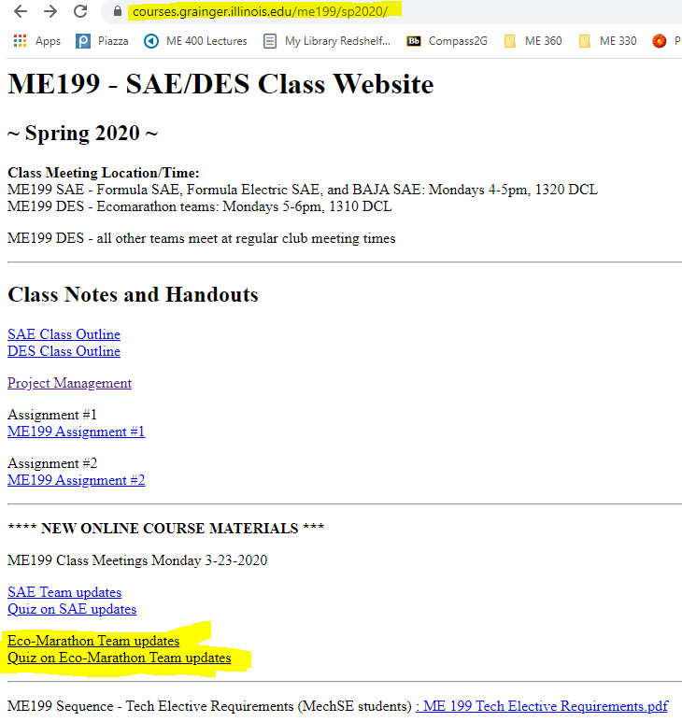
ME 199 and Class Participation
In-class participation suspended
Meetings temporarily on hold
Course Evaluation: (How we will evaluate/give you a grade)
Participation on projects/planning through the rest of SP 2020
Completed CAD Assemblies of projects
Email skamzol2@Illinois.edu for Solidworks
If unable to run, see below
Team Wiki:
Post project work, information/research, methods towards completing your project, and status of project → Why did you do what you did???
List where future development could be made (if any)
Paper: Write conclusion of where project is left at, steps needed to finish it, and rough time needed to assemble/test
Attendance: Take “Quiz”; based on these PPT’s!

Slide 5

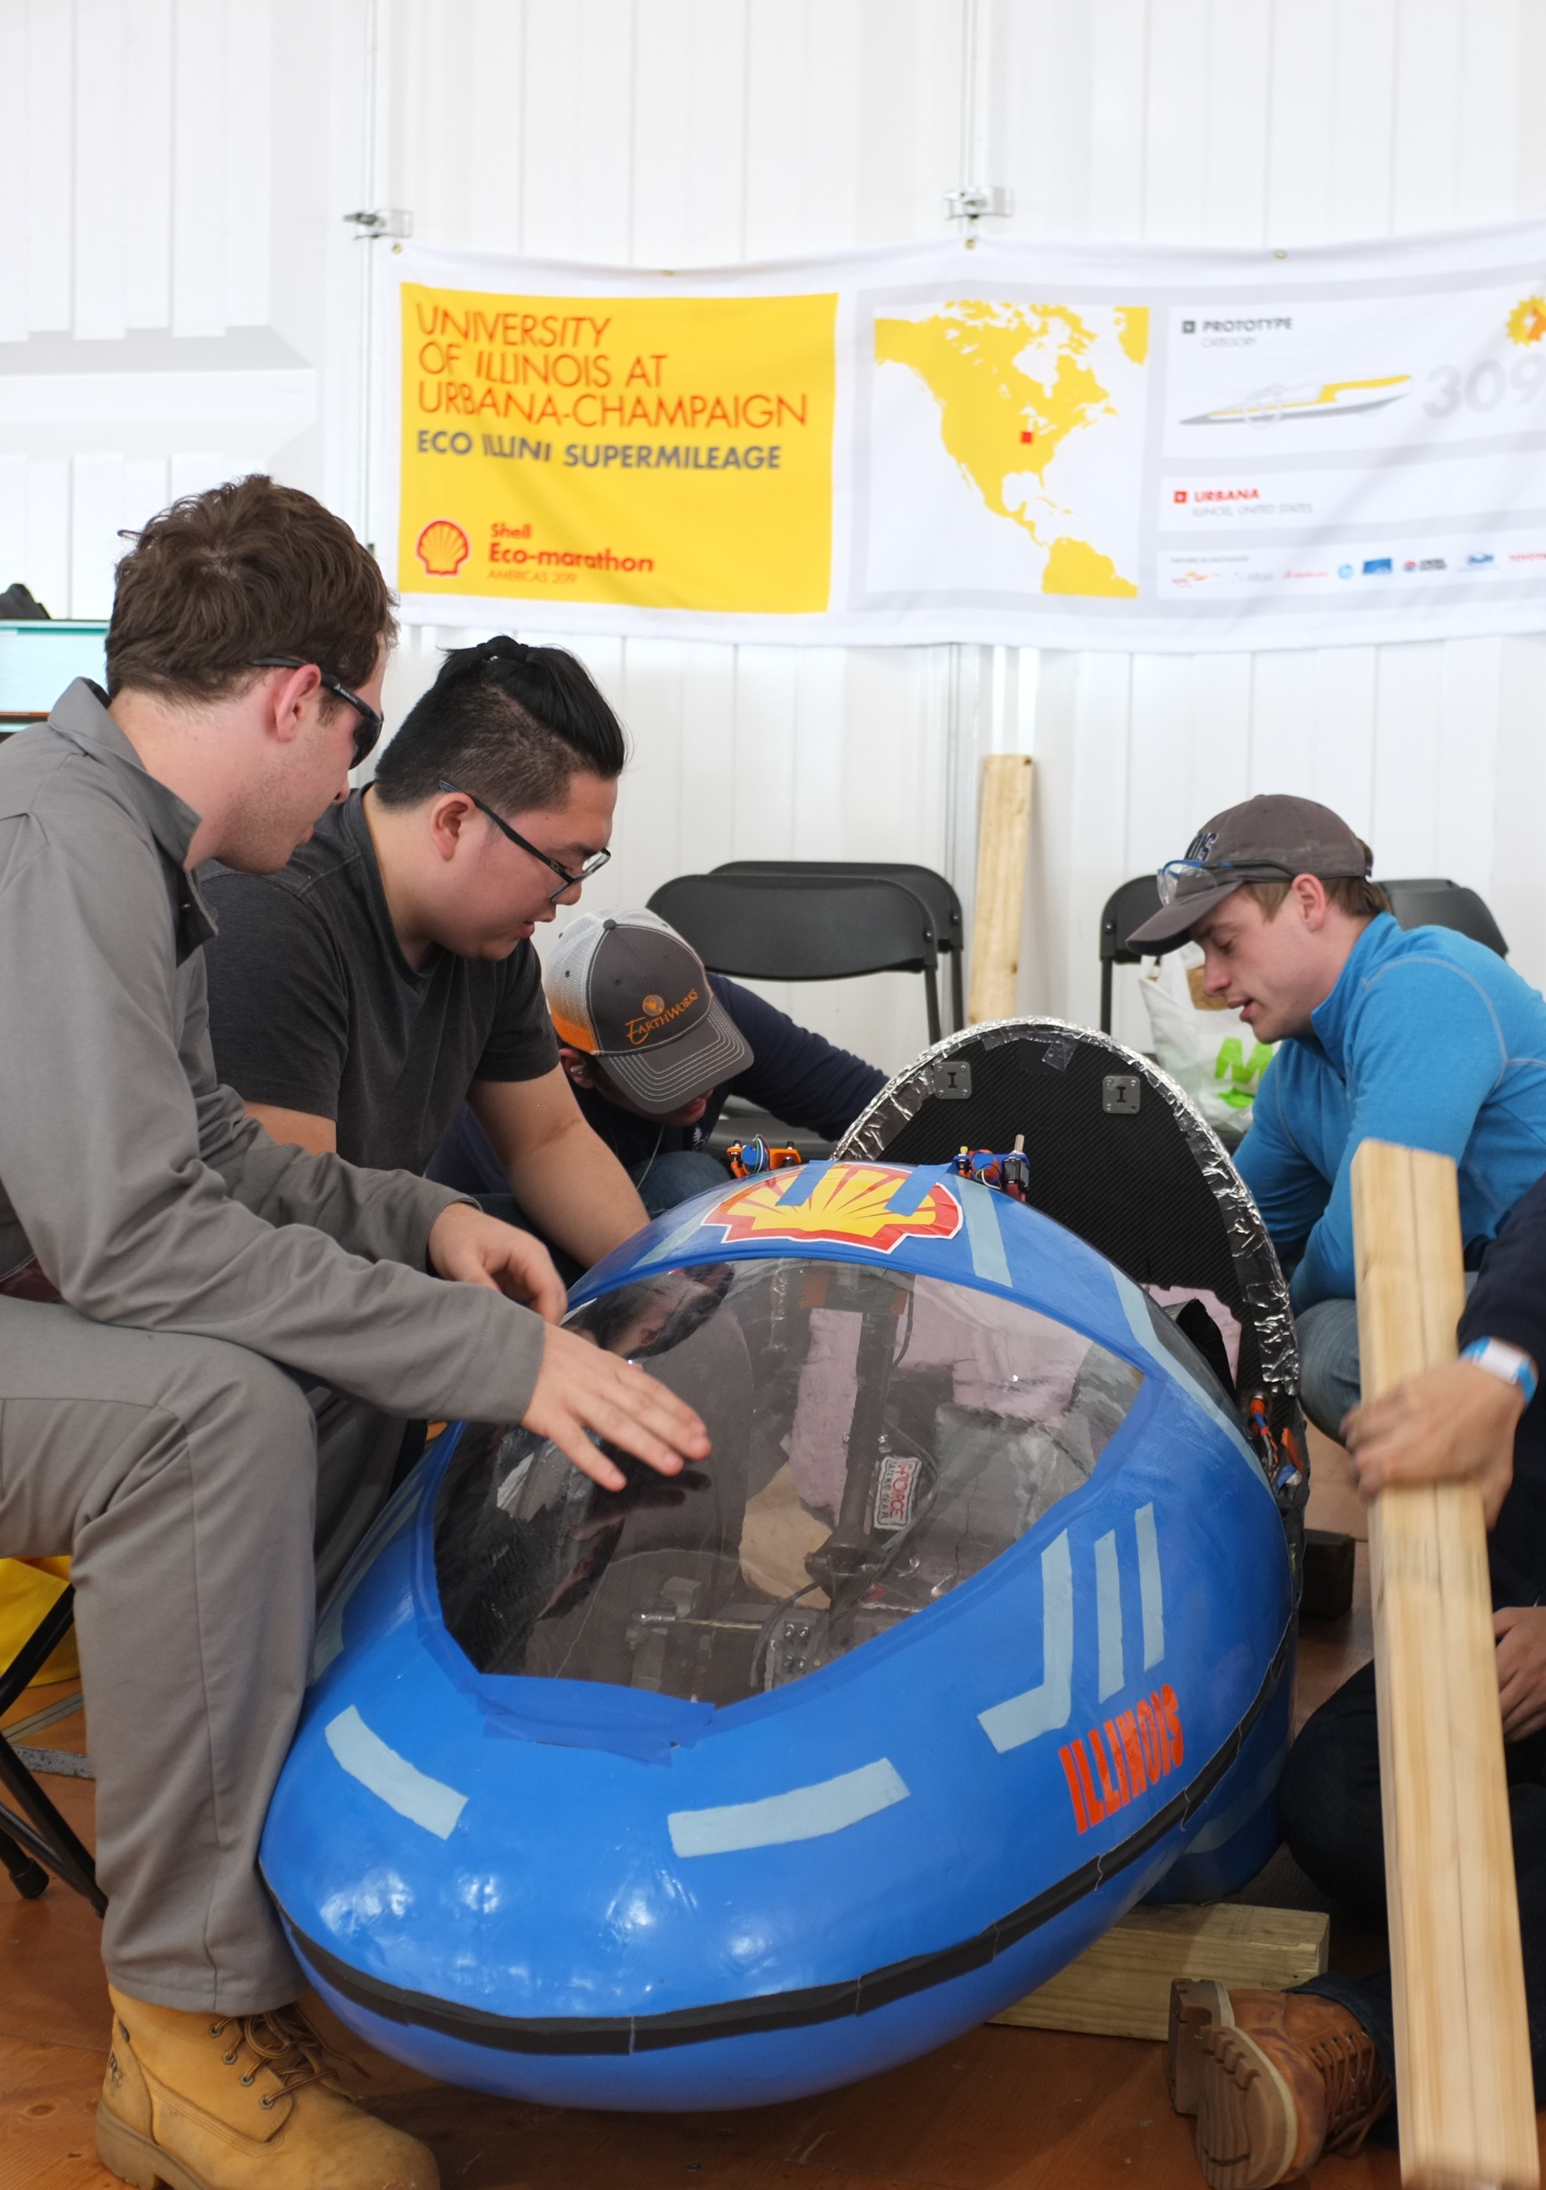
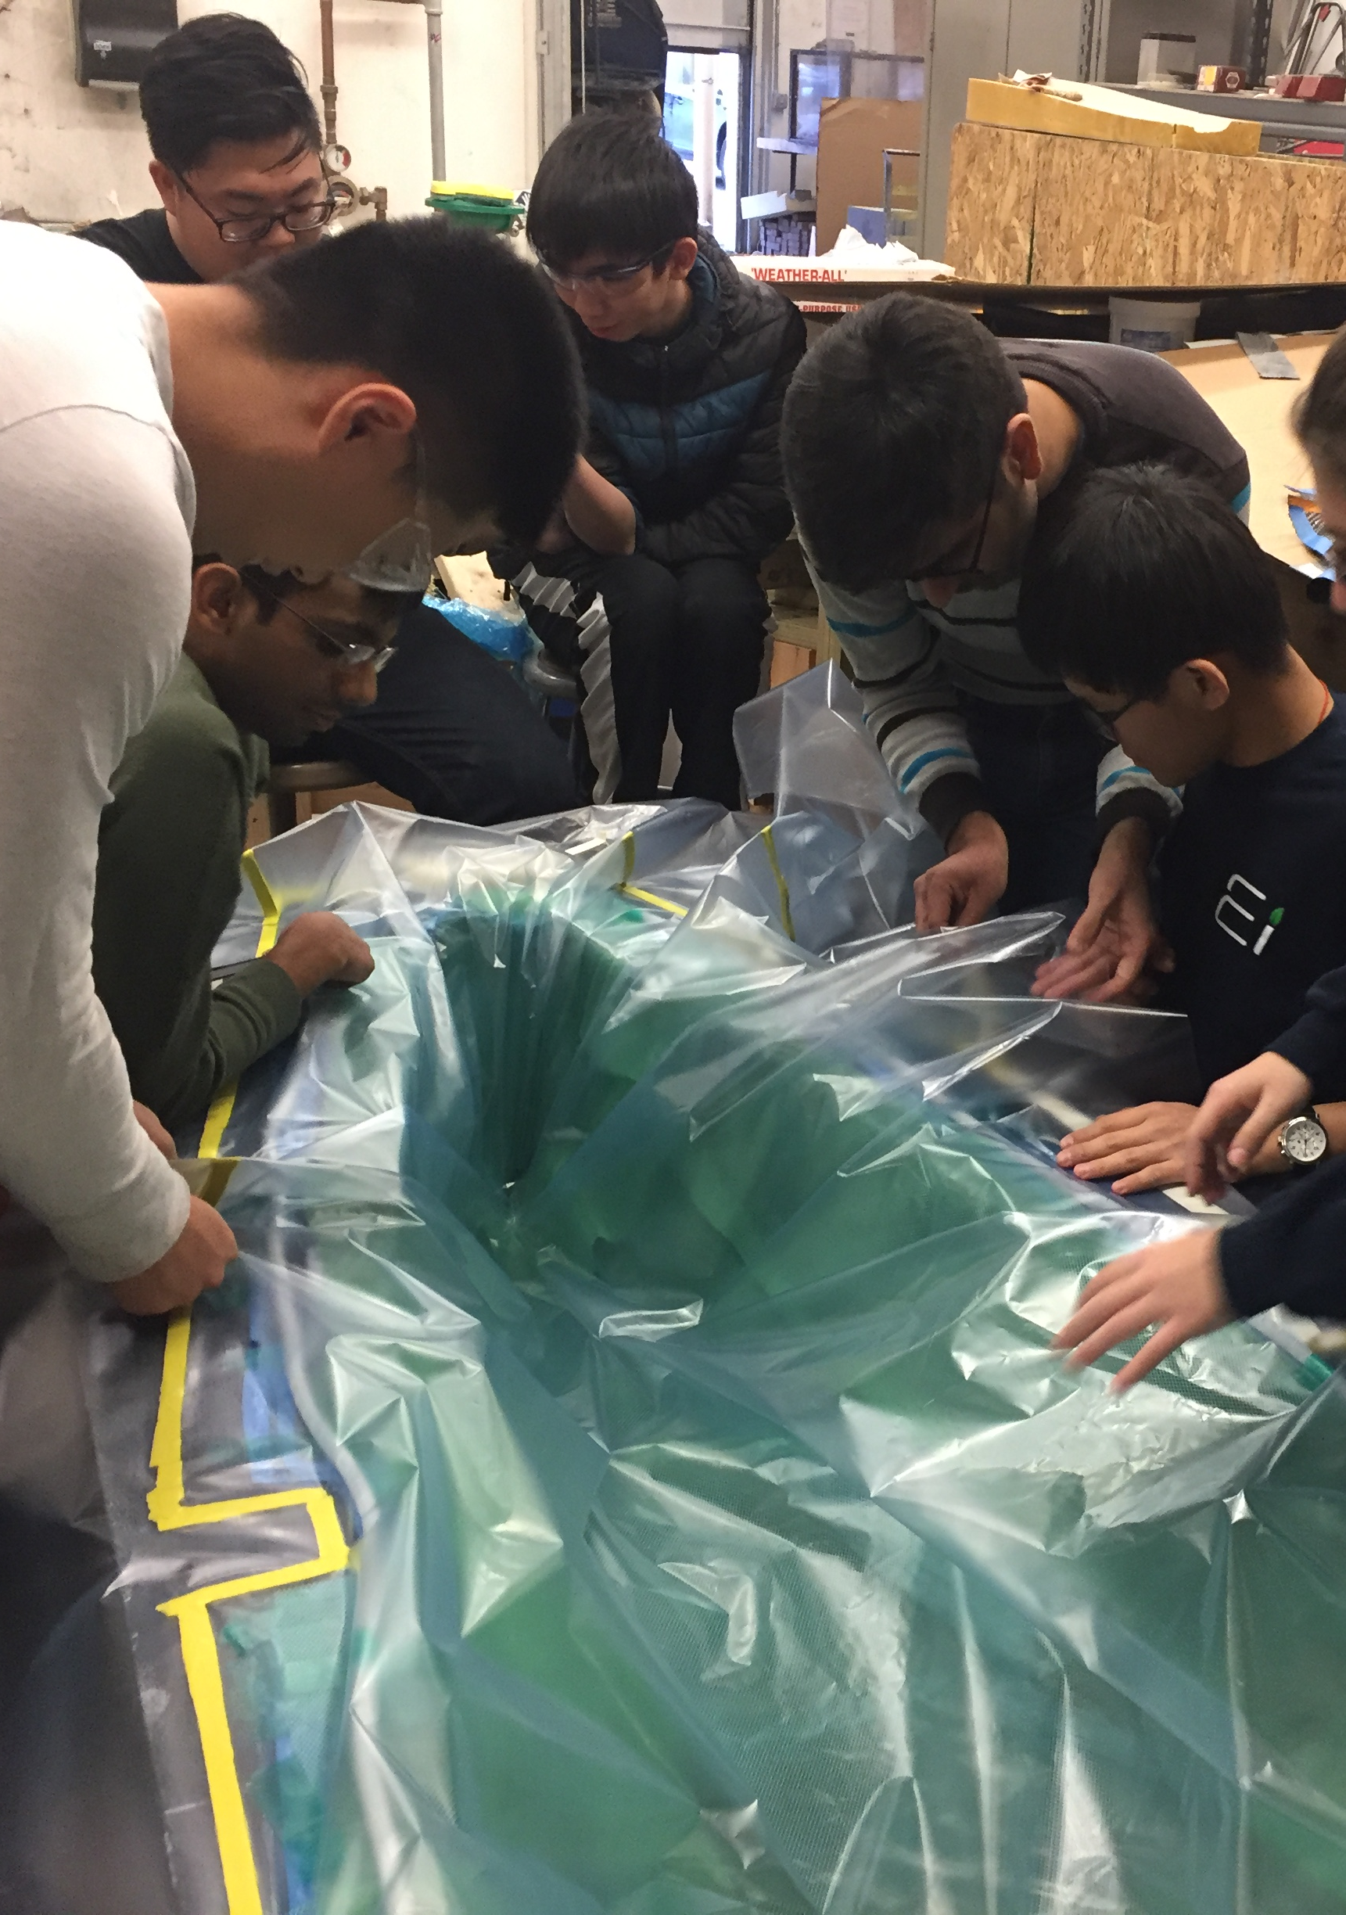
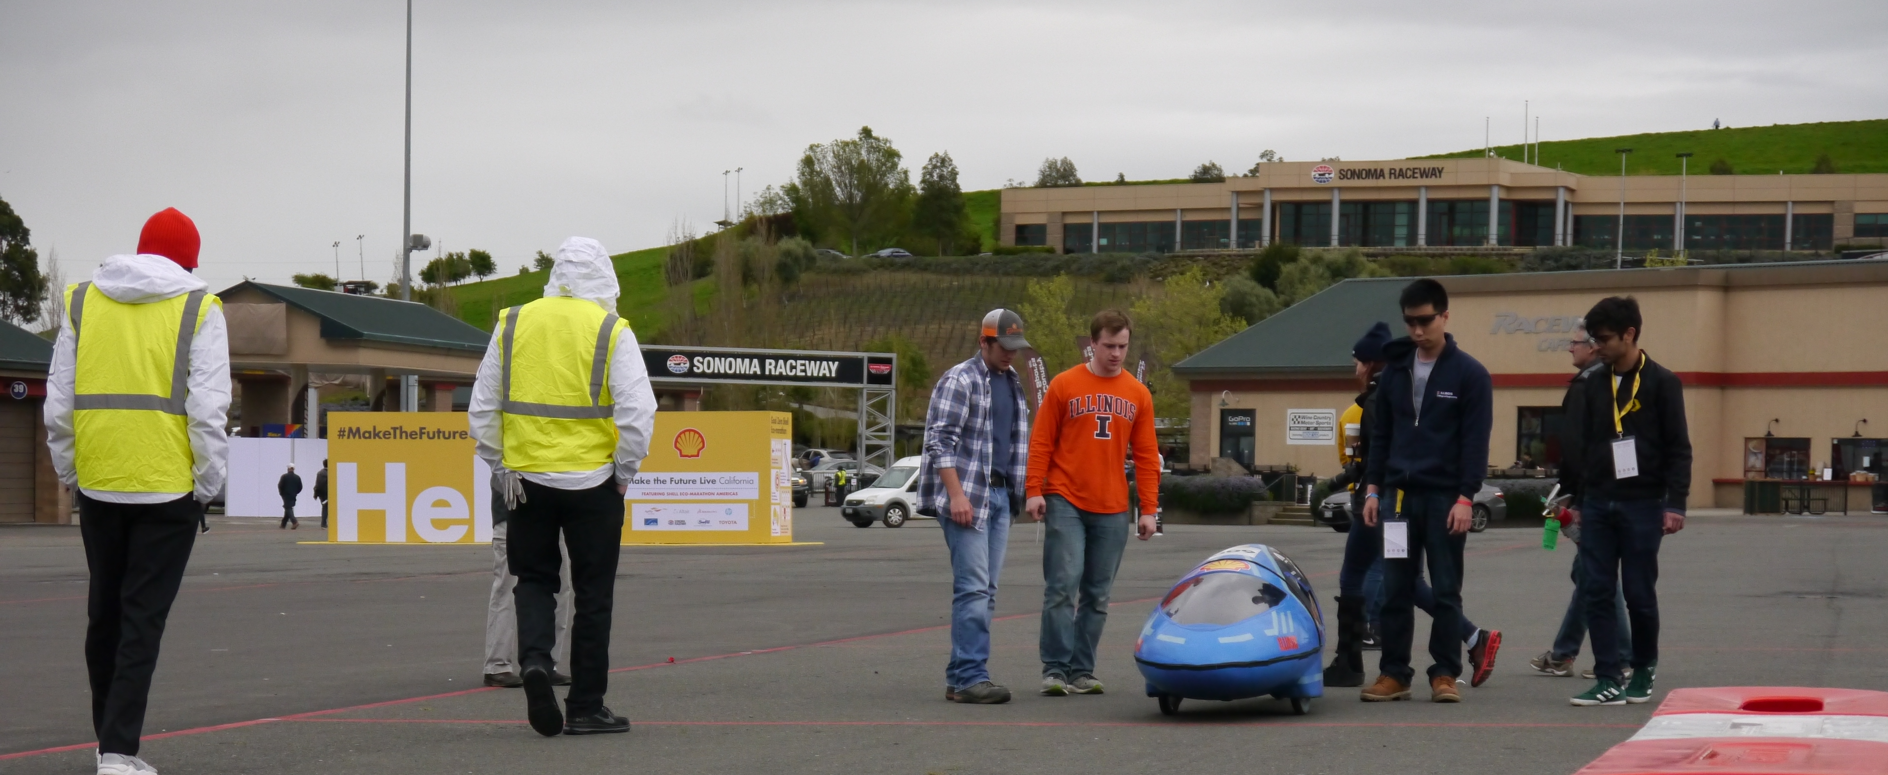
Mechanical

Slide 6
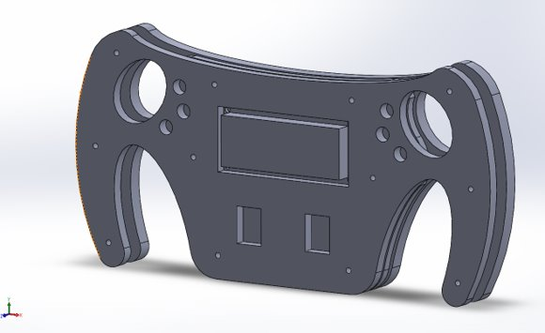
Mechanical
Working on assemblies
Design new gear for electrics drivetrain
Mechanical Subteam arrangement for next year
Goal: Place specialists in charge of different critical subgroups
Workflow plans managed between subsystem and specialist leads
Keep members engaged and provide central contact/chain for development
Structure for 2020-2021
Mechanical Lead
Engine Lead
Dynamics Lead (Brakes/Steering)
Testing Lead

Slide 7
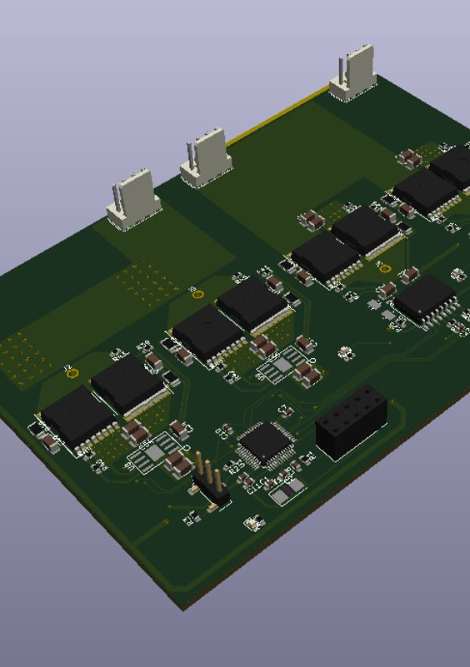
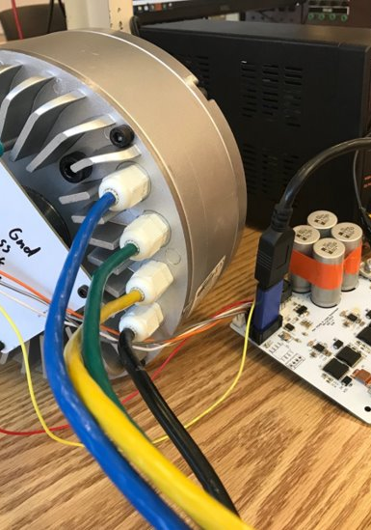
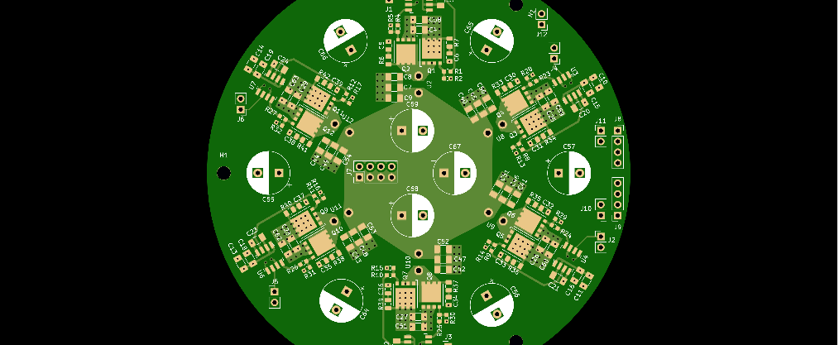
Electrical

Slide 8
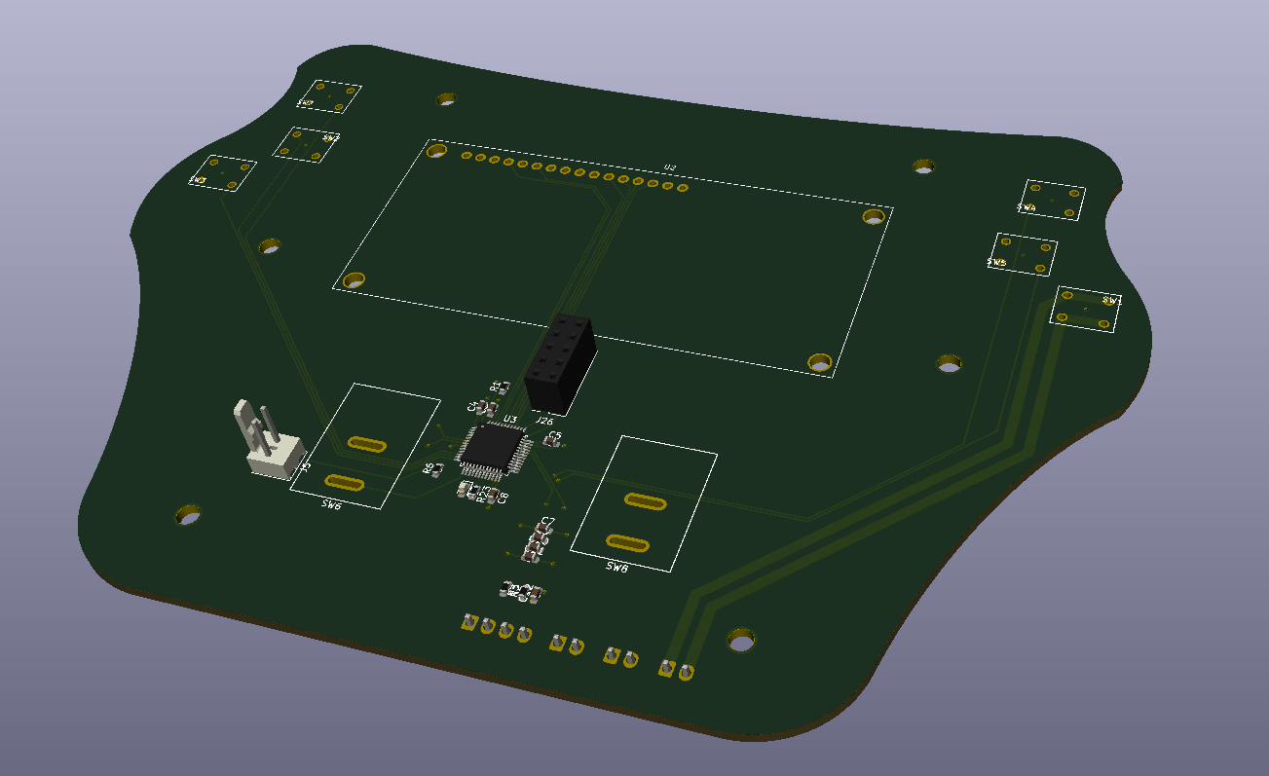
Electrical
Shifting gears from electrical to gas for SAE
Battery manufactured
Steering wheel pcb design
Working on motor mounting issues
Moving back to shelved projects
Alex moves to joint-Eco lead developer
New Electrics subteam lead

Slide 9
Manufacturing

Slide 10
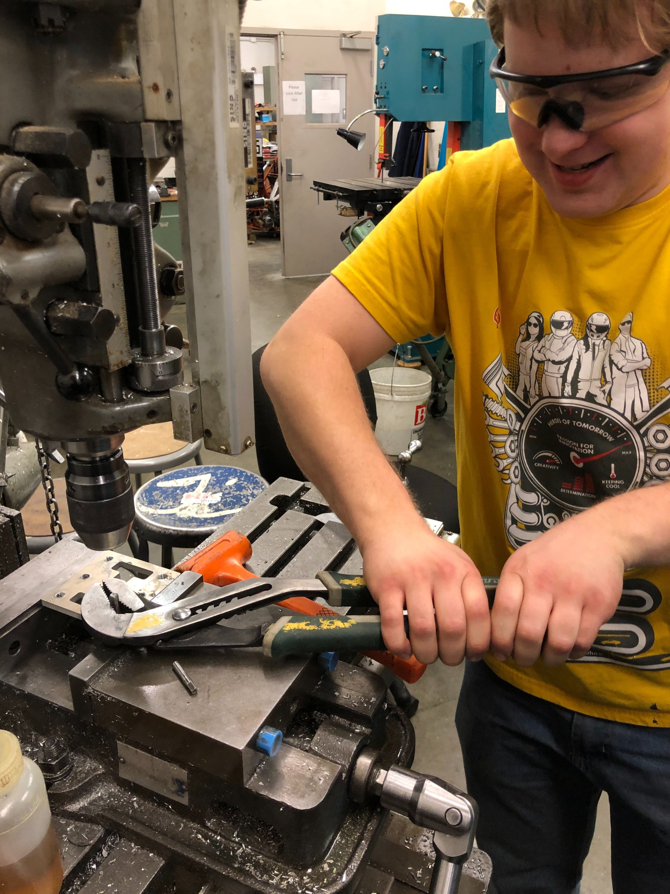
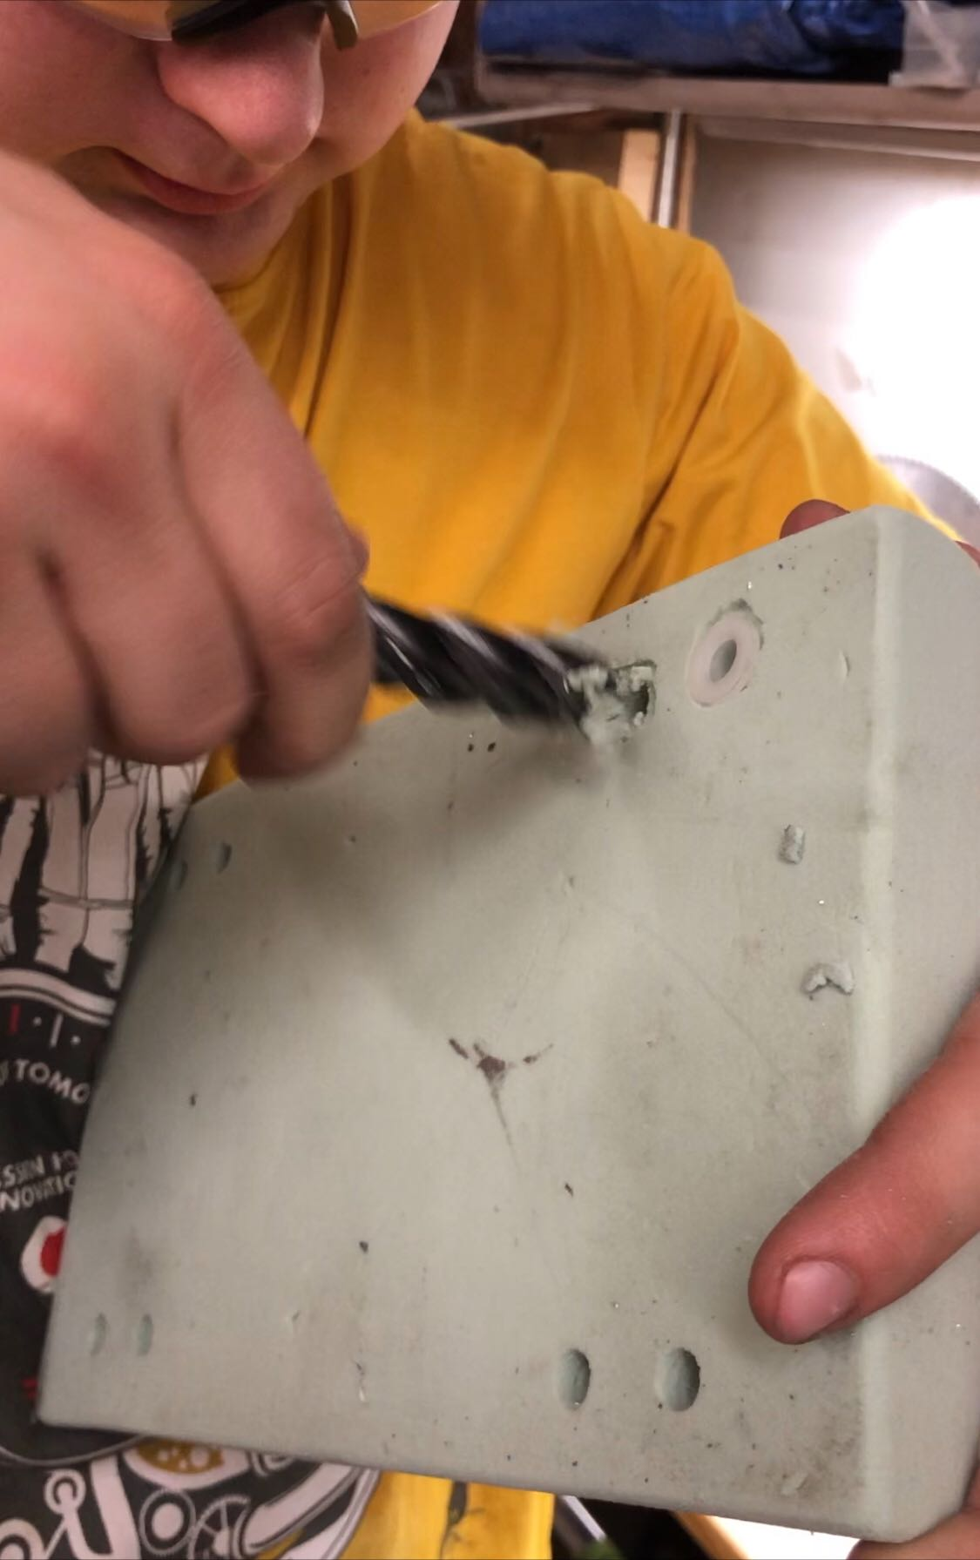
Progress
Waterjet – 98% (need new gear)
Machining: ~85% complete
Welding: ~50% complete
Highlights
Rolling car ready

Slide 11
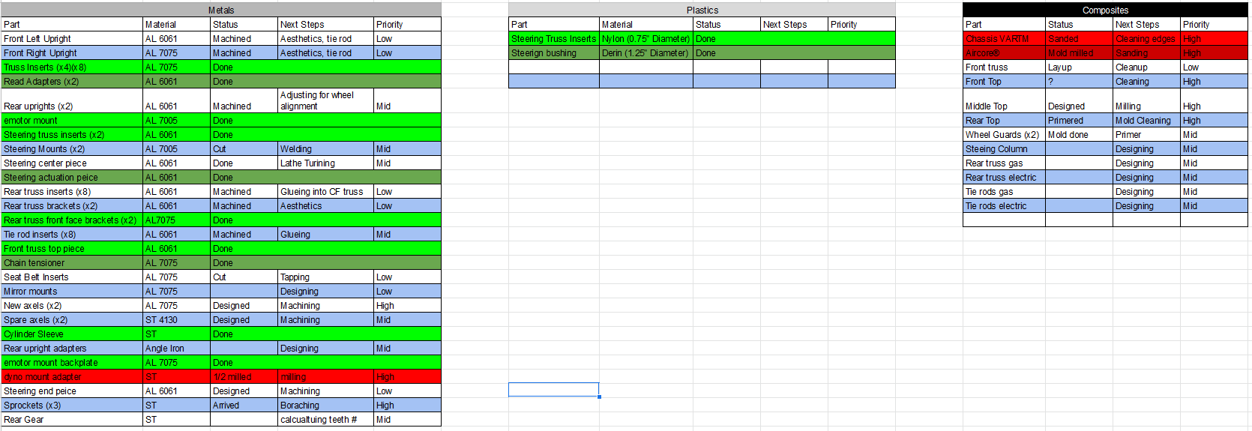
Manufacturing

Slide 12


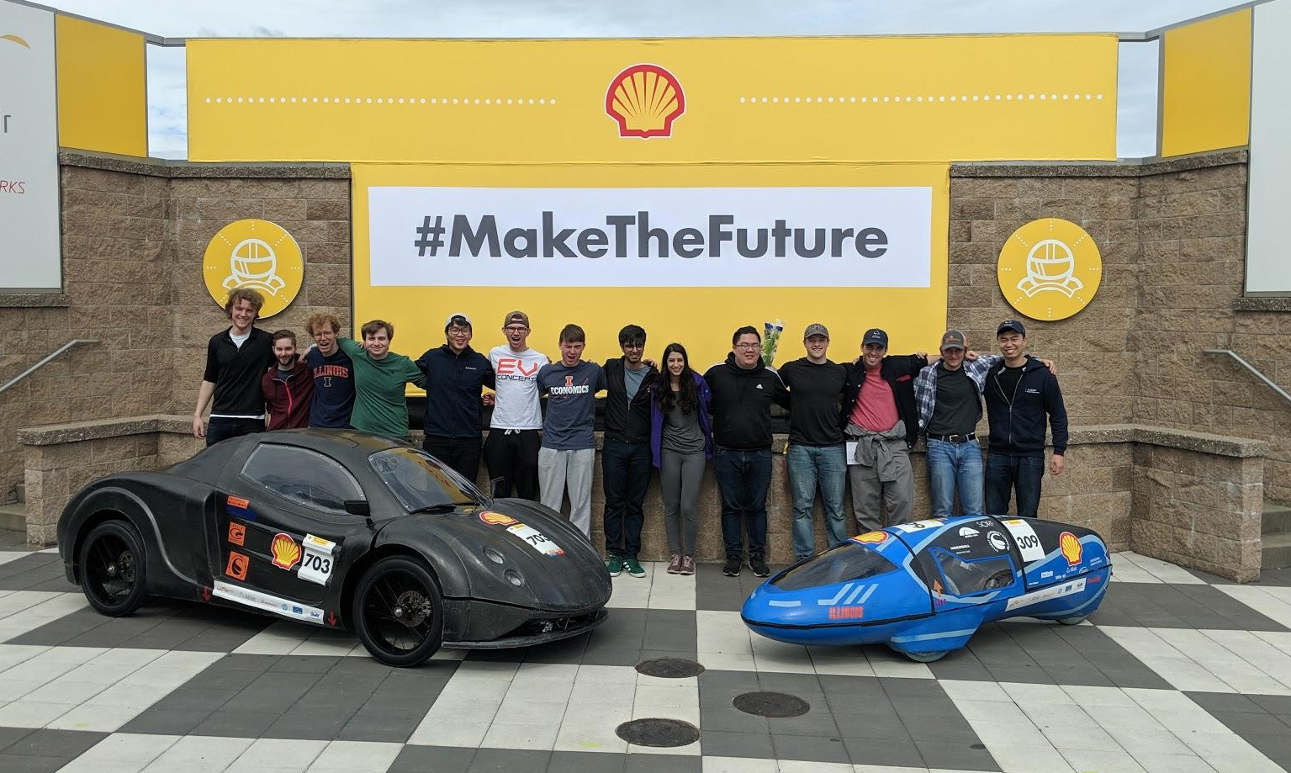


Slide 13
Administrative - Robert Mauge
Reached out to Nicholas from SCD
Team is likely to obtain space in SCD
Trisected space: assembly space, manufacturing space, office space
Build progress has been halted since March
Uncertain of when the building will open up
Bottom line: we have space, but might not be right at the start of Fall 2020
Projects lead meeting to be held this week
Going over transitional updates
Discussing what needs to be done in prep for next year

Slide 14
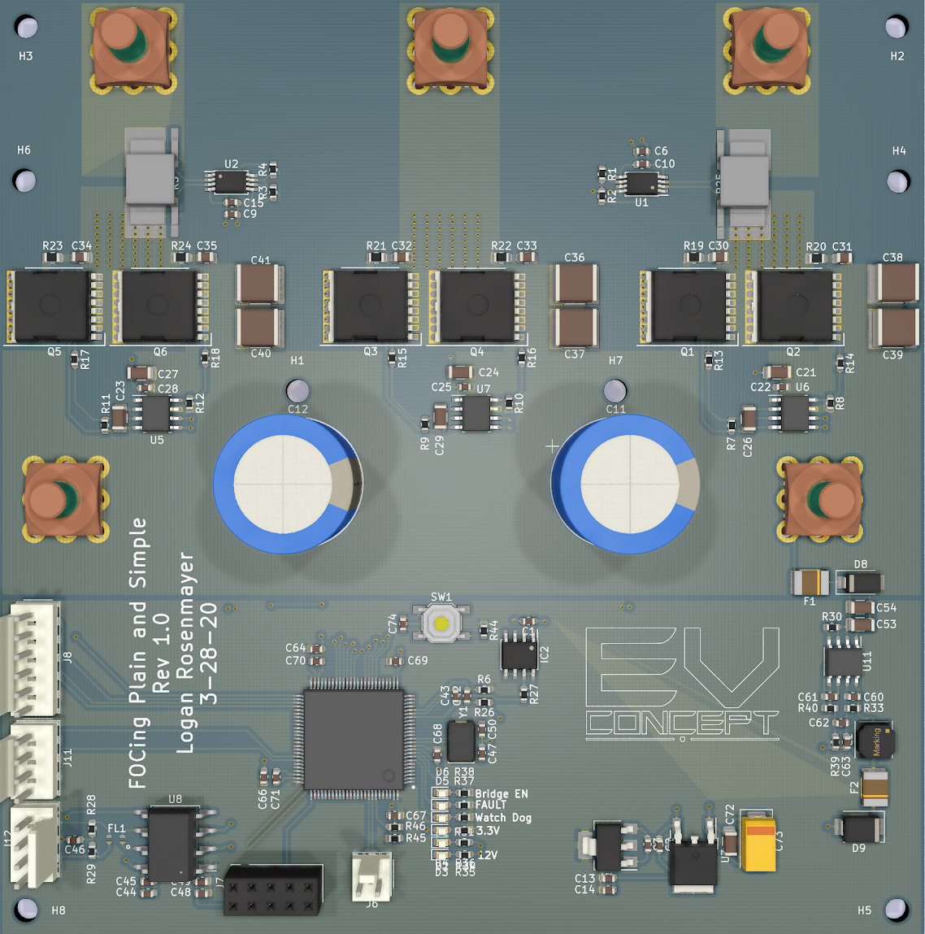
Electronics Team - Moving the Car
Waiting on Alex from Eco Illini to proof new motor controller board
Gave lecture on motor control theory to prep next years team
Will follow up by walking through design decisions and calculation of current motor controller next week

Slide 15
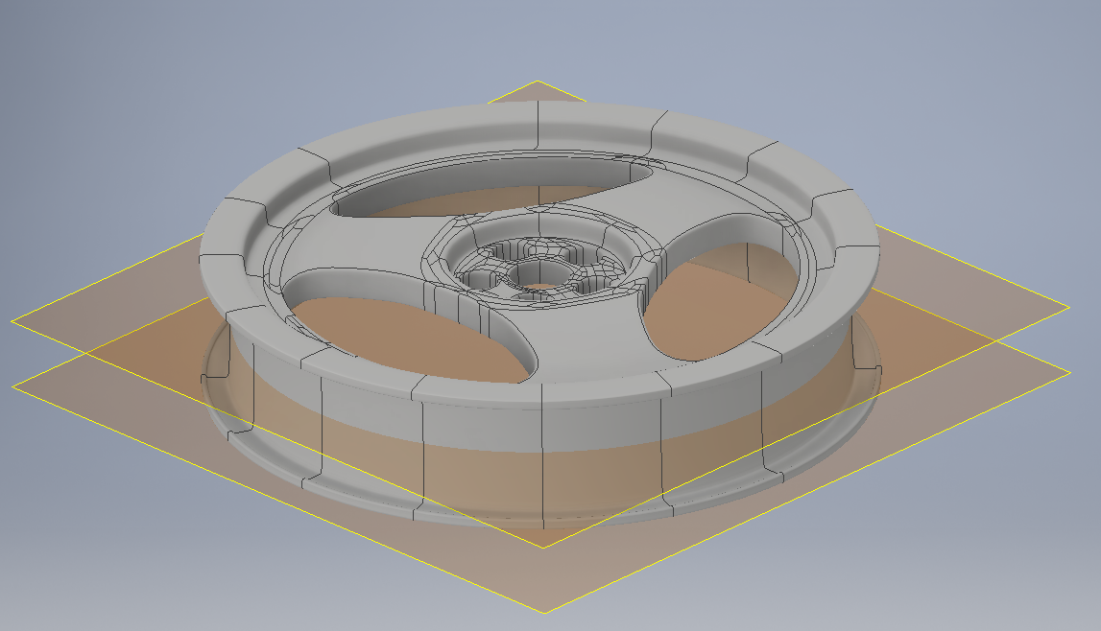
Composites Team - Richard Mauge
Foam core carbon fiber rim design in case 2 part design fails
Machine in 2 halves, paste foam halves after machining
VARTM directly over foam after laying carbon fiber directly on foam

